Slide 1
Oral submission to GW NRP PC1 Hearing Stream Two on 11 April 2025
Submitter S282
Pat van Berkel
Community member of
Te Whanganui-a-Tara Whaitua committee

Slide 2
Para 106 + 120 (of S42A report)
S282.002 Publish timeline to 2100
WH.O1 “The health of all freshwater bodies (rivers, lakes, etc) and the coastal marine area within Whaitua Te Whanganui-a-Tara is progressively improved and is wai ora by 2100”.
For example, add to WH.P3: the timeline of ALL the future actions, in broad statement through to 2100, shall be published and confirmed/updated each three years.

Slide 3
Para 118 S282.005 Mangaroa Peatland
Add a clause to the NRP that protects significant peatlands.
(eg, a similar objective to WH.O5 which refers to the health and wellbeing of the Parangarahu Lakes and associated wetlands.)

Slide 4
Paras 131+137 S282.006
“Primary contact”
S42A report suggests defining “Primary contact” by inference from the definition of “Primary contact site”
Definition correctly omits mentioning monitoring water quality
No mention of dangers to dogs
Add site – S282.020 below
Create separate list of sites and allow some sites to have no monitoring

Slide 5
Paras 131+137 S282.007
Make map names in the appendices searchable.
Eg, Map 85 (Primary contact sites)

Slide 6
Para 280+324 S282.011, 012, 013
Swimmable days
Add “swimmable days” or “non-swimmable days” to Table 8.3, WH.O9 and Table 8.4.
This parameter is easily understood by the public and is in fact the measure that counts.

Slide 7
Para 281 S282.010, 011
Cyanobacteria
Add a measure of “benthic cyanobacteria” or “cyanobacteria blooms” to Table 8.3.
To measure something, and record the measure, is to know of its existence.
At present there is no reporting of measures of cyanobacteria.

Slide 8
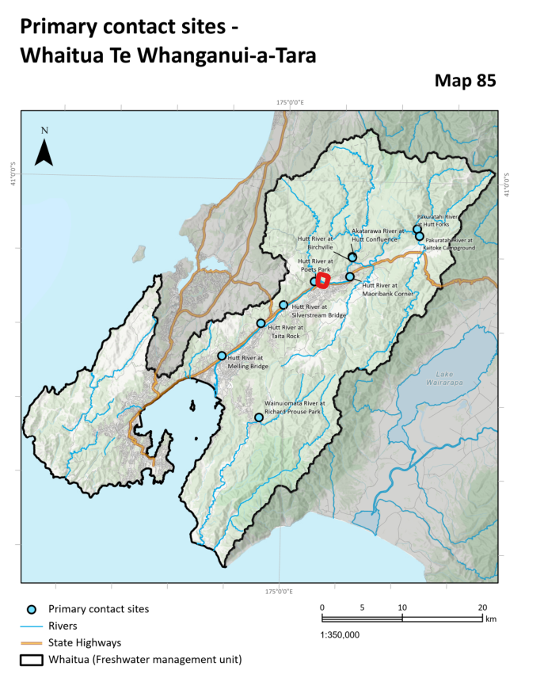
Para 380 S282.020 Add sites
Add primary contact site: Whakatikei River at Hutt Confluence” (red dot on map) to Map 85, Table 8.3, Table 8.4.
Add Speedy’s Stream swimming hole.

Slide 9
Para 6 Sediment
The approach taken accepts that the sediment already deposited over the last 100 or so years is taken as given.
Actually we need to reduce the sedimentation rate below natural levels to counteract the huge amount of sediment now carpetting the Onepoto Arm and Pauatahanui Inlet

Slide 10
Para 290 Responsibility for achieving Wai ora ?
Crux of the problem
Repeat: S282.002 requests the publishing of the complete future timeline to make the changes through to 2100
Include who, when, what, priorities
Timeline signed by TAs, GW, WWL, Mana whenua

Slide 11
Para 291 S282.003 2040 or 2060 ?
Get the loans
Train staff
Get on with it
Finish by 2040

Slide 12
Thank you

