Slide 1
Oral submission to GW NRP PC1 Hearing Stream One on 5 Nov 2024
Submitter S282
Pat van Berkel

Slide 2
S282.002 WH.O1
WH.O1 “The health of all freshwater bodies and the coastal marine area within Whaitua Te Whanganui-a-Tara is progressively improved and is wai ora by 2100”.
Modify WH.O1 to add: the timeline of ALL the progressive stages (to achieving a state of wai ora by 2100) shall be published and confirmed or updated each three years.
Modify WH.P1 to P4 to require a statement of how each city is going to implement the Whaitua recommendations including the limits in PC1.

Slide 3
S282.003 Section 8.1
Section 8.1 Objectives presents two options regarding the timeline for achieving the e-coli target attributes state: 2040 or 2060

Slide 4
S282.005 Mangaroa Peatland
Add a clause to the NRP that protects significant peatlands.
(eg, a similar objective to WH.O5 which refers to the health and wellbeing of the Parangarahu Lakes and associated wetlands.)

Slide 5
S282.007
Make map names in the appendices searchable.
Eg, Map 85 (Primary contact sites)

Slide 6
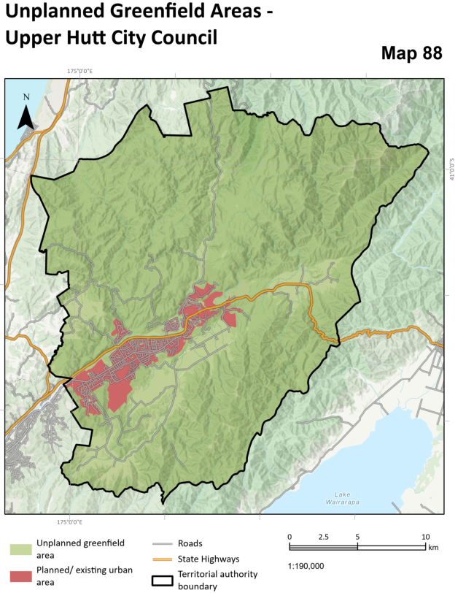
S282.008 Unplanned greenfield development
“Other Land “ ?

Slide 7
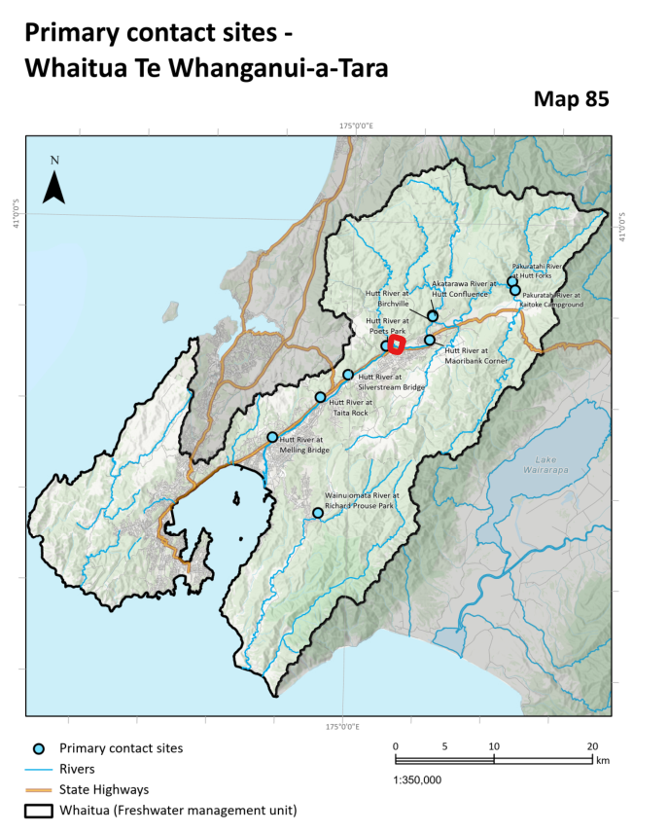
S282.020, 10, 11, 12, 13 WH.O8 and O9
Add site: Whakatikei River at Hutt Confluence” (red) to Map 85, Table 8.3, Table 8.4
Add “non-swimmable days” and “benthic cyanobacteria” to WH.08 and WH.09

Slide 8
S282.014 and 15 WH.P10 and 11
WH.P10 Stormwater discharges and WH.P11: Discharges of contaminants refer to “where practicable” or “where avoidance is not practicable” to discharging stormwater or contaminants.
Add to WH.P10 (c) Where a stormwater treatment system is judged not practicable consider not undertaking the activity.

Slide 9
WH.P10
WH.P10 recommends the use of water sensitive urban design (WSUD)
Examples of WSUD should be included such as permeable surfaces and rainwater collection tanks. Alternatively include an Appendix that gives a comprehensive description of water sensitive urban design.

Slide 10
S282.016 and 17 WH.P14
WH.P14 assumes that (ground) surfaces in a development are impervious but the policy should assume that surfaces are permeable as required by water sensitive urban design.
Add to WH.P14 (a) to reduce runoff through permeable surfaces (eg, for minor roads, carparks, etc)

Slide 11
S282.018 and 19 Rule WH.R33
Recommendation 83 of the Te Whanganui-a-Tara Whaitua Committee recommends gradually raising the minimum flow of Te Awakairangi, Orongorongo and Wainuiomata rivers to 80% of MALF (mean annual low flow) over a 50 year period. At present the minimum flow of Te Awakairangi is at 30% of MALF. The 50 year period is between 2021 and 2071.
Modify rule WH.R33 (and associated tables) to define the staged increases in minimum flow that are required between 2021 and 2071, to meet recommendation 83.
eg, increase by 10% of MALF per decade.

Slide 12
Thank you

