Slide 1
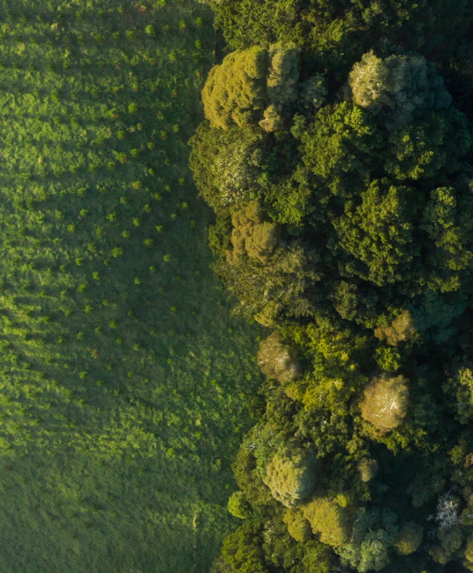

Submission on
Proposed Plan Change 1 to the Operative Natural Resources Plan for the Wellington Region
preserving our planet for future generations
5 November 2024
Peter Casey
CEO
Tayla Westman
Corporate Counsel and Environmental Planner

Slide 2
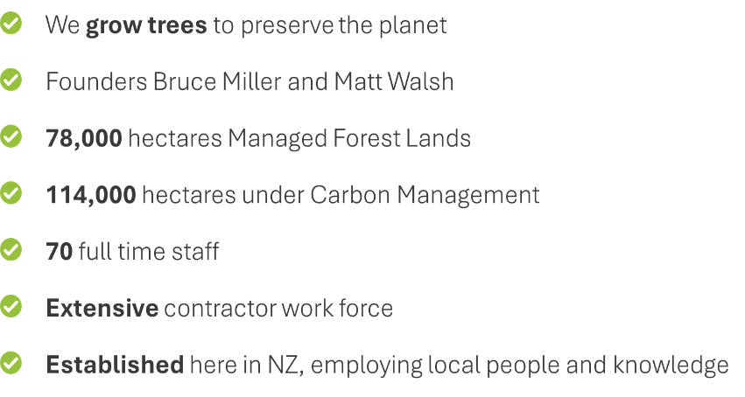
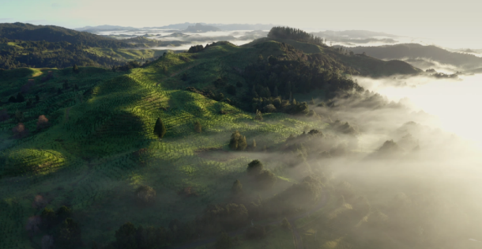
New Zealand Carbon Farming - Who are we

Slide 3
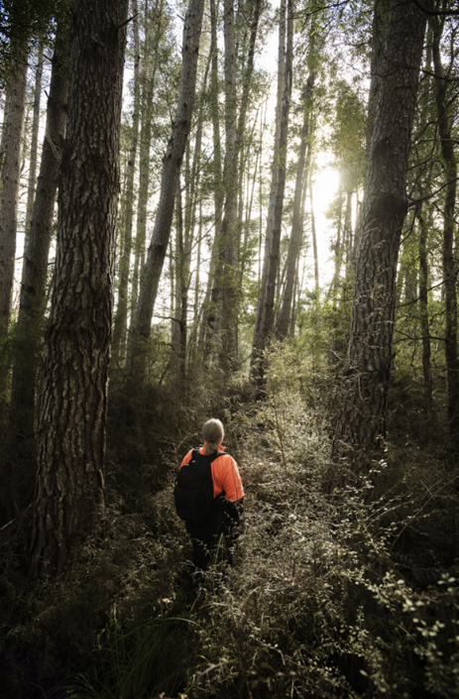
What do we do
The focus of the business is to concurrently:
  sequester carbon to make a real difference in climate change; and
  to provide a long-term lasting legacy of resilient and biodiverse native forest in its permanent forest estate.

Slide 4
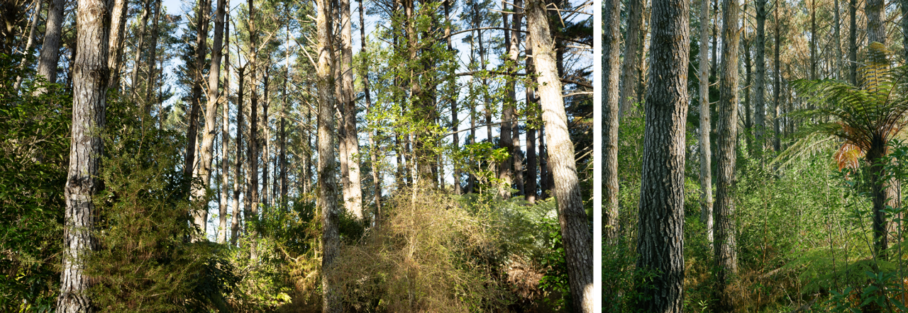
Strong forest ecology insight underpins our Forest Management Regime

Slide 5
Three key matters – today:
NZCF wishes to be heard today on the following 3 key matters:
    Given that the final form of the Wellington Regional Policy Statement (WRPS), which also gives effect to the National Policy Statement Freshwater Management (NPSFM), is yet to be determined, it is premature to notify NRP provisions that must also give effect to the NPSFM. NZCF prefers that the WRPS is determined first to avoid inefficiencies;
    Greater weight should be given to the recommendations of the Te Whaitua te Whanganui-a-Tara Implementation Programme and the Te Awarua-o-Porirua Whaitua: Whaitua Implementation Programme (together, the “Recommendations”) so that the Recommendations are accurately and appropriately reflected in PC1; and
    Greater focus should be given to achieving environmental outcomes through effective management of the effects of activities, rather than blanket removal of land uses in particular areas, with particular focus given to Policy WH.P28.

Slide 6
Amend Policy WH.P28:
Achieving reductions in sediment discharges from plantation forestry
“Reduce discharges of sediment from plantation forestry by:
(a) identifying highest erosion risk land (plantation forestry),
(b) improving management of plantation forestry by requiring erosion and sediment management plans to be prepared and complied with, and
(c) requiring that on highest erosion risk land (plantation forestry), plantation forestry is not established or continued beyond the harvest of existing plantation forest.”

Slide 7
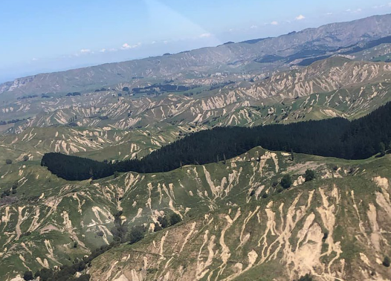
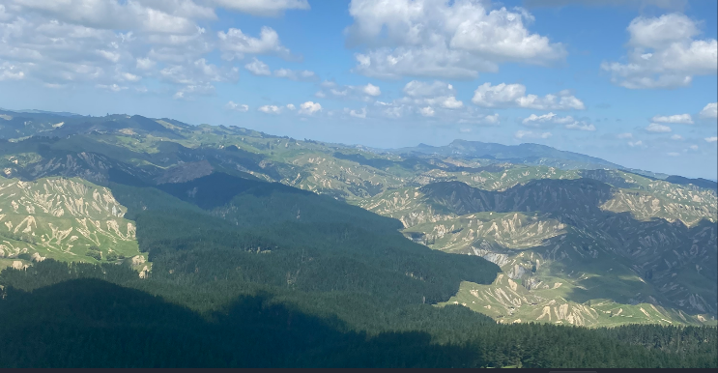
One of many reasons why Forest Cover Matters:

Slide 8
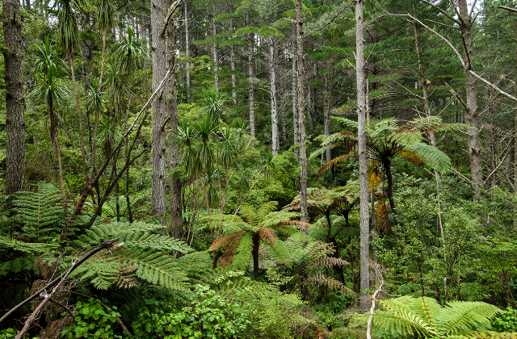
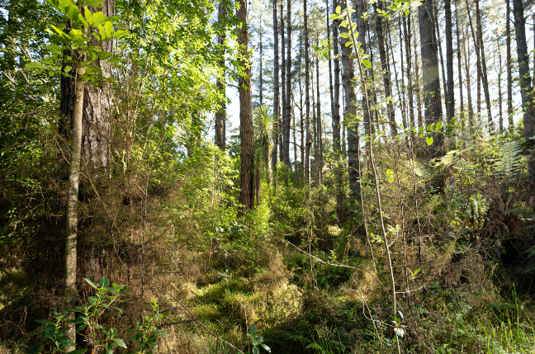
Exotic Nurse Crop Forest and Native Regenerating Forest Cover:

Slide 9
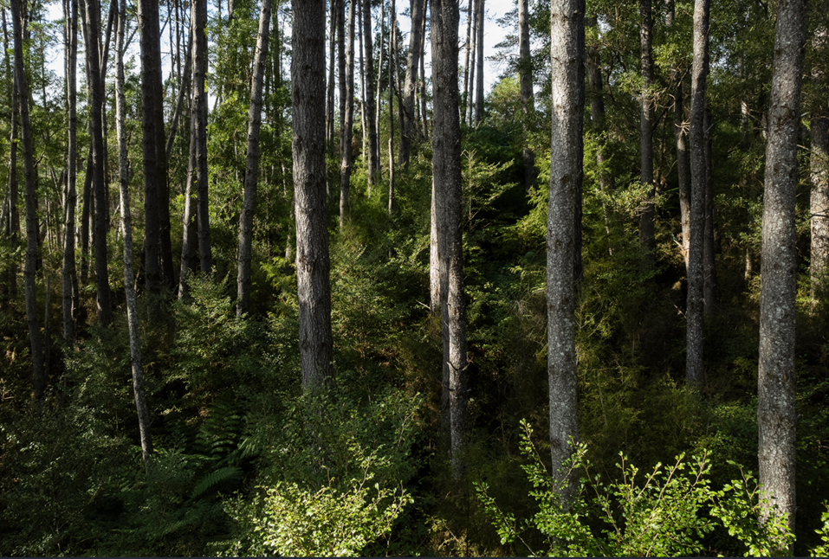
Exotic Nurse Crop and Native Regenerating Forest Cover

Slide 10
