Slide 1
General Submission Points - GWRC PC1 Hearing 1
Submission of China National Forest Group Ltd
Submitter S.288.
Scope of Submission Points^{*1}:
S288.001 & 2
S288.003-288.17
^{*1} Document: Proposed PC1 –Submission points ordered by Submitter Alphabetically

Slide 2
Introduction
Who is China National Forest Group (CFG)
Presenter
Purchased the Cutting Rights to all the exotic plantation forests previously owned by GWRC.
These forests are located in lower and Upper Hutt, Porirua/Kapiti and Wairarapa areas.
All local management rests with Forest 360 – locally based in Porirua,Fielding and Masterton.
Total NZ area owned by CFG= 29,925ha.
Ex GWRC forest area cutting rights= 3,600.
Christopher (Kit) Richards
47 yrs involvement in industry.
20yrs Environment Manager PF Olsen Ltd –Exposure in all regions of NZ including initial period post GWRC sale of forest cutting rights.
NZIF Registered Forestry Consultant (RMNZIF & FNZIF).

Slide 3
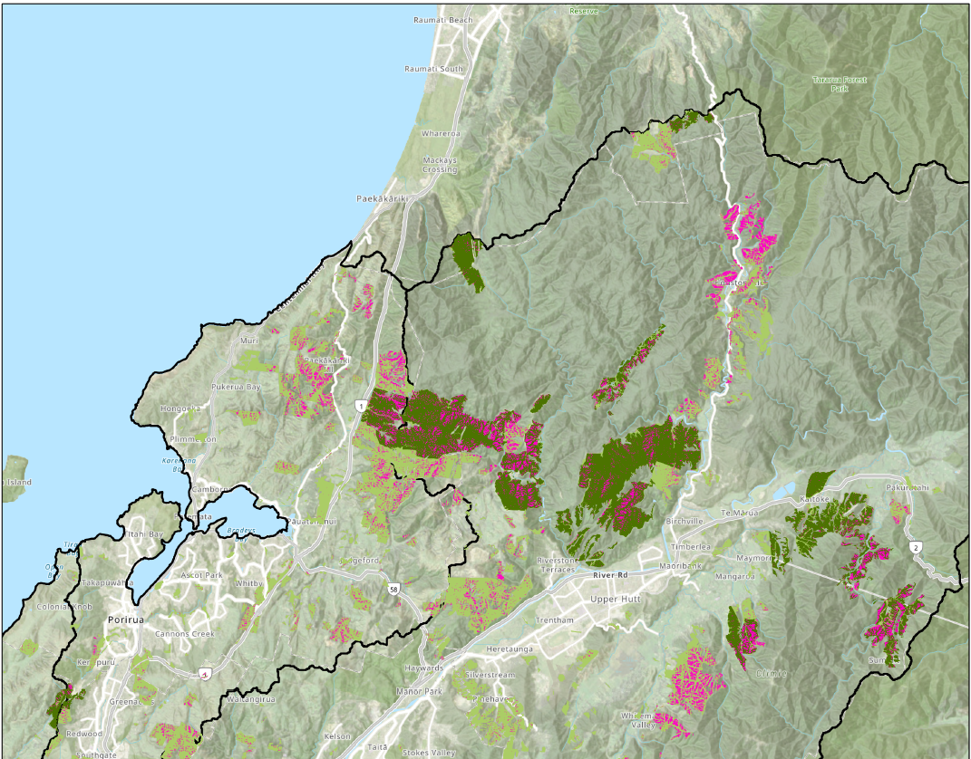
Affected CFG Forests
Te Whanganui-a-Tara
Involved estate (net):
Te Awarua-o-Porirua = 244ha
Te Whanganui-a-Tara = 3,392
Te Awarua-o-Porirua
The CFG estate is represented by the dark green shading.
GWRC proposed erosion risk areas in pink.
Adapted from map: Erosion Risk GWRC Forestry

Slide 4
Presentation -
Key Themes
Themes
Proposed rules extend beyond the recommendations of the Whaitua Committees
Submission point S288.001, 288.003. Related matters on consultation will be further expanded upon in Hearing Stream 3 “General Comments – Consultation”
_________________________
The proposed rules are not well supported by GWRC’s water quality data sets and stated assumptions.
Submission point S288.001, 288.004 – 011. This matter will be further expanded upon in Hearing Stream 3 “General Comments – (including) current legislation, target attribute states and water quality improvements”
_________________________
GWRC did not adequately consider the costs and liabilities involved in management of/around high erosion risk areas and implications under the emissions trading scheme.
Submission point S288.012 – 017. This matter will be further expanded upon in Hearing Stream 3 “General Comments – Economic cost/impact”
In aggregate, there are 3 common themes arising from the submission points classified within GWRC’s plan provisions as “General Comments” & “General Comments – plantation forestry”^{*2}.
These are to be heard within hearing stream 1”.
^{*2} GWRC Guide –to-allocation of provisions to heating streams and topics September 2024

Slide 5
Theme 1:Proposed rules extend beyond the recommendations of the Whaitua Committees
CFG in its primary submission, drew attention generally around the management of the consultation processes, including specific concerns (Pg 13) related to the divergence of outcomes between the Proposed PC1 rules affecting forestry and the recommendations of the Whaitua Committees.
It is our clear understanding that the Whaitua Committees’ work (that extended through multiple years) was a key vehicle by which community representation was engaged in the plan development process.
The forestry sector in the Whaitua catchments is characterised by relatively few moderate to large forest holdings and numerous small holdings.
There was sector representation in the earlier stages of the Te Awarua-o-Porirua Whaitua deliberations but no participation in the Te Whanganui-a-Tara deliberations.
Notwithstanding the apparent lack of representation for a significant land occupying sector, the final recommendations of the Whaitua Committees did not recommend rules solutions that are now proposed in PC1

Slide 6
Te Awarua-o-Porirua
“The Committee considered whether more stringent rules were required to achieve the sediment objectives and concluded that the permitted framework of NES-PF should be given time to be implemented”.
“The Committee did, however, think it was important to ensure the forestry operations were carried out in compliance with good practice and the NES-PF requirements and recommended all permitted forestry operations were monitored for compliance and enforcement action taken where necessary”.
No recommendation was made that plantation forests should be retired or that there was any specific identifiable need for high levels of stringency exceeding the controls available under the then NES-PF (now NES-CF).
Appendix 1(a) of the CFG substantive submission contains the text of relevant TAP recommendations

Slide 7
Te Whanganui-a-Tara
SUPPORTING BEST PRACTICE AND COMPLIANCE OF FORESTRY OPERATIONS
37 “Greater Wellington provides enough staff and resources to:
  Work with forestry groups (New Zealand Farm Forestry Association, New Zealand Forest Owners Association) and contractors to provide proactive advisory support that includes ensuring all forestry operators are aware (by 2023) of relevant regulatory requirements and good practice.
  Ensure all forestry operators in the whaitua are monitored for compliance with the National Environmental Standard for Plantation Forestry (NES-PF) and other relevant requirements from 2023 onwards and share this monitoring information with the community.
  Take enforcement action on non-compliance”
Appendix 1(b) of the CFG substantive submission contains the text of relevant TAP recommendations
Conclusion: PC1 represents a material deviation from the recommendations and signals arising from the work of the Whaitua committees. GWRC should have engaged in constructive consultation with the sector given the substance of the proposed changes.

Slide 8
Theme 2: The proposed rules are not well supported by GWRC’s water quality data sets and stated assumptions.
CFG in its primary submission – Secn 1.3 pgs 15-24, raised concerns generally that the cause effect relationship being implied in PC1 between forestry as a land use and water quality, was not well substantiated by the Councils own monitoring data.
PC1 documentation included statements suggesting large areas of future harvesting would lead to an implied deterioration of water quality.
Reviewed the available data for 5 monitoring sites all downstream from plantation forests.
Reviewed history of forestry operations in catchments.
Whaitua | Stream with plantations | WQ Monitoring site | Involved Plantation
Te Awarua -o-Porirua | Horokiri Headwater | Horokiri at Snodgrass | Prt Puketiro
Te Whanganui-a-Tara | Whakatikei | Whakatikei at Riverstone | Prt Puketiro
 | Akatarawa | Akatarawa at Hutt | Hukinga
 | Akatarawa | Akatarawa at Hutt | Valley View
 | Akatarawa | Akatarawa at Hutt | Akatarawa
 | Pakaratahi | Pakaratahi r | Pakaratahi W
 | Mangaroa | Mangaroa at Te marua | Mangaroa
Appendix 2(a) -2(c) of the CFG substantive submission contains details of relevant TAP targets and GWRC water quality monitoring.

Slide 9
What was found
Monitored Stream | Harvest Exposure | NOF Clarity | Dep Sed | Suspen Sed* | Total* | MCI | EPT | Overall | *Both Horokiwi and Pakuratahi had very poor SS and Total SS Maxima suggesting high transport/erosion events on occasion.
Horokiwi | 1.61% over 20yrs | D | A | Poor | Good | B | Med/Hi | Med/Hi | Intermittent harvesting/earthworks. Mainly 2015-2017 recommenced 2022.
Total catchment was approx. 3000ha – average harvesting exposure (bare ground to green-up approx. 4yrs) Thus the exposure was approx. 1.6% over the last 20years. Much of the catchment is lowland pastoral use. Stream is meandering and low energy through much of its lower reaches through pasture. Ecological report for plantation noted fish survey data indicated high rankings for diadromous species in upper adjacent Horokiwi.r TAP action plan seeks A for MCI, sediment targets related to estuarine deposition.
Whakatete | 2009-2017 | A | A | V.good | V.good | A | High | High | Tall native forest dominates the catchment. Plantations in middle reaches, reversion and urban in lower reaches.
Extended period of harvesting /earthworks upstream of monitoring site in river mainstem. Harvest largely complete. TAT action plan seeks NOF ‘A’.
Akatarawa | 2009-2014 | A | A | V.good | V.good | A | High | High | Tall native forest dominates catchment. Exotic forests on hills in lower reaches
Extended period of harvesting /earthworks upstream of monitoring site in river mainstem. Harvest largely complete. TAT action plan seeks NOF ‘A’.
Pakuratahi | nil | A | A | V.good | V.good | B | Med/Hi | Med/Hi | Tall native forest and shrubland dominates – some small patches of plantations
No significant harvesting nor earthworks undertaken to date above monitoring site. TAT action plan seeks NOF ‘A’.
Mangaroa | 2018-2020 | D | A | V.good | Good | C | Med/Hi | Med/Hi | Upper catchment and tributaries dominated by native forest + small plantation areas in lower side tributaries. Lower mainstem and valley floors are pastoral agriculture.
Harvesting largely completed by 2020 and largely greened-up by 2022 with riparian setbacks. Ecological report in CFG adjacent tributary detected fish and suggests WQ in small plantation tributaries likely better than main stem. TAT action plan seeks A for clarity long term but C for short term, A for Dep.sediment short & long term and B MCI short term , A long term.

Slide 10
Contributary issues – Water quality
Forest extent
Temporal nature
Were PC1 outcomes based on perceptions of catchment occupancy?
3 monitored streams were meeting or nearly meeting NOF targets.
2 streams fell well short Mangaroa & Horokiri.
Low performing catchments had low plantation occupancy
See slide “Catchment Occupancy”
Did PC1 outcomes fail to recognise the temporal nature of forest operations?
Research has established that harvesting and especially earthworks can increase sediment delivery above base lines.
Baselines generally return to close to normal (native cover) after 4-5yrs.
Proportions of a catchment exposed to harvest has been temporal and often quite small.
See slide “Temporal Nature”
Conclusion: CFG do not believe that GWRC has sufficient justification to call on NES-PF Regulation 6 to incorporate significant stringency for rules on forestry.
Recent case: Rayonier NZ LTD and Port Blakely Ltd Vs Canterbury Regional Council is relevant. (Hearing 3 matter)

Slide 11
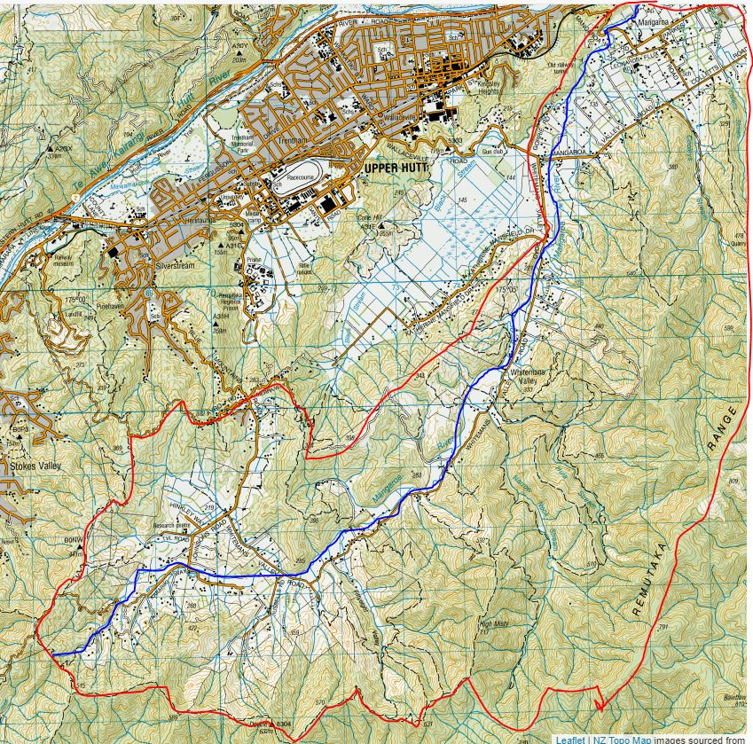
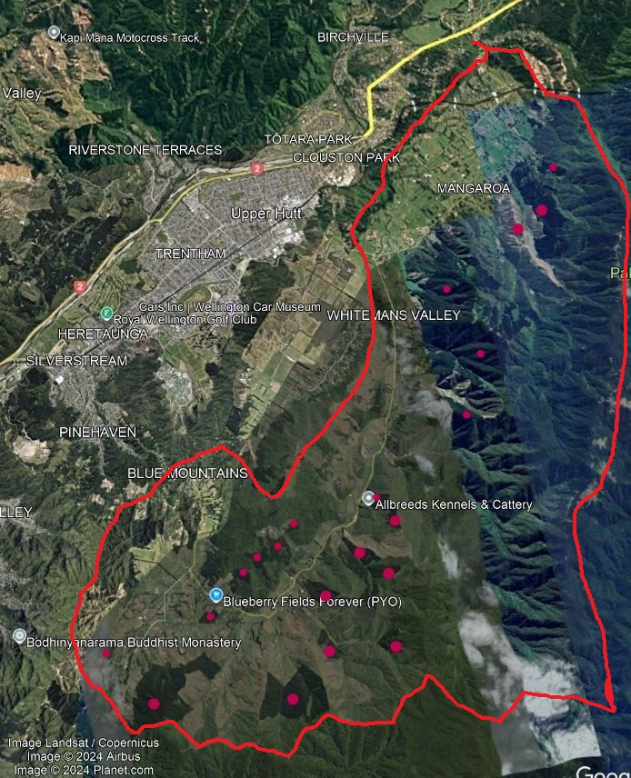

Catchment Occupancy

Slide 12
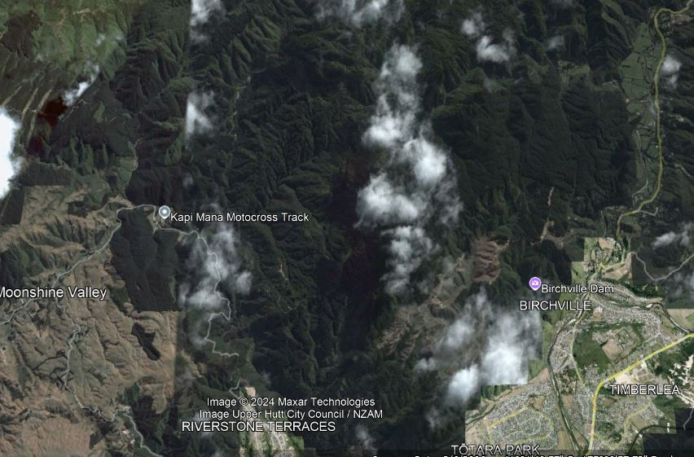
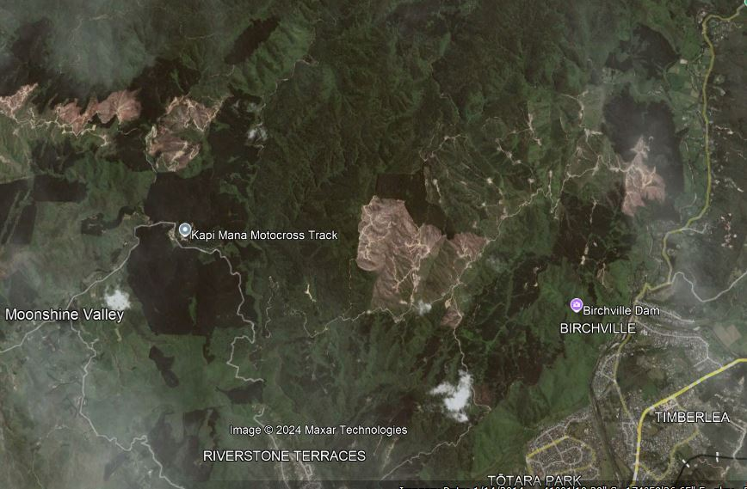
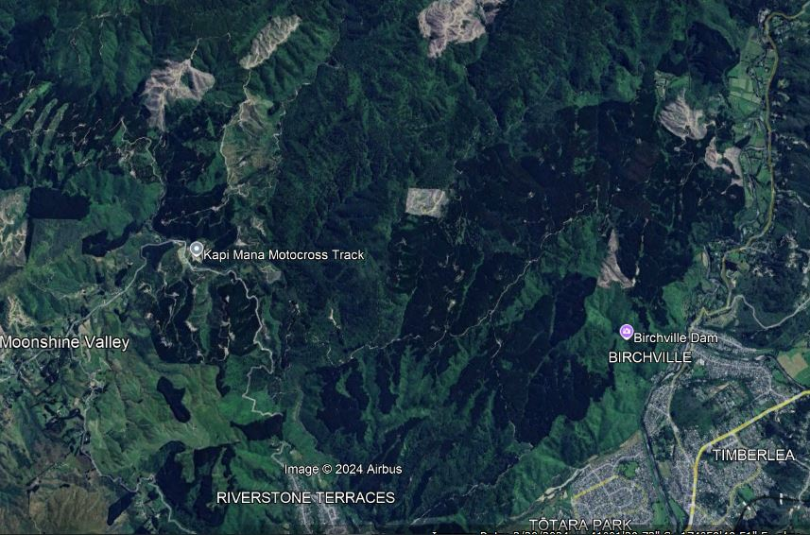
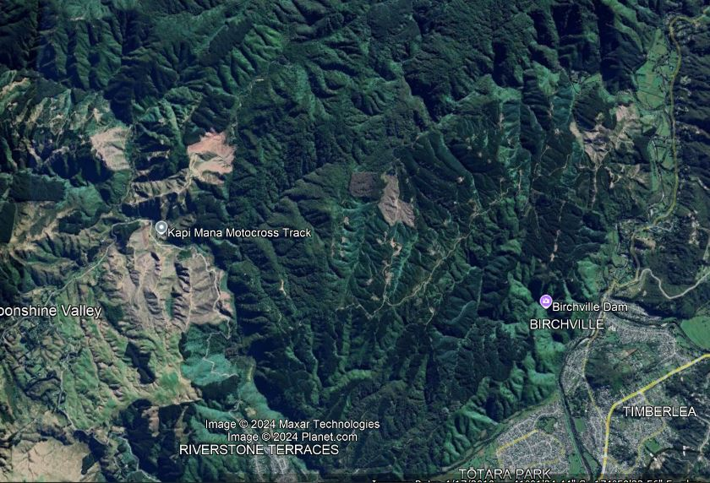
Temporal Nature
2009
2014
2024
2019

Slide 13
Theme 3:GWRC did not adequately consider the costs and liabilities involved in management of/around high erosion risk areas.
CFG in its primary submission – Secn 1.4 pgs , raised concerns generally that about the approach to defining the highly erodible plantation forest areas (this will be addressed in hearing 3)
That the theoretical application of the areas as defined will see an average of 9% (and up to 18% in one forest) of the productive estate retired.
Practical application of the high-risk erosion designations will lead to ‘pixelation’ of the land rendering a much higher proportion unworkable.
The costs associated with this effect, the costs and responsibilities arising from retirement and the liabilities arising from the ETS were not recognised nor considered including in the Secn 32 report.
Whaitua | Forest | Gross Area | Net plantation | Plantation (high risk) (ha) | %lost
Te Awarua-o-Porerua | Puketiro | 254.2 | 243.7 | 33.3 | 13.6
Te Whanganui -a-Tara | Puketiro | 1106.9 | 1,077.4 | 131.9 | 12.2
 | Akatarawa | 45.6 | 43.6 | 0.6 | 1.4
 | Hukinga | 299.7 | 233.8 | 25.7 | 11
 | Mangaroa | 146.3 | 141.0 | 23.3 | 16.5
 | Puketiro | 227.3 | 196.4 | 35.1 | 18
 | Pakaratahi | 534.7 | 464.8 | 33.2 | 7
 | Valleyview | 1124.7 | 1,085.7 | 47.5 | 4
 | Whakatikei | 153.7 | 149.3 | 1.3 | 0.8
Total |  | 3,892 | 3,636 | 331.8 | 9.1

Slide 14
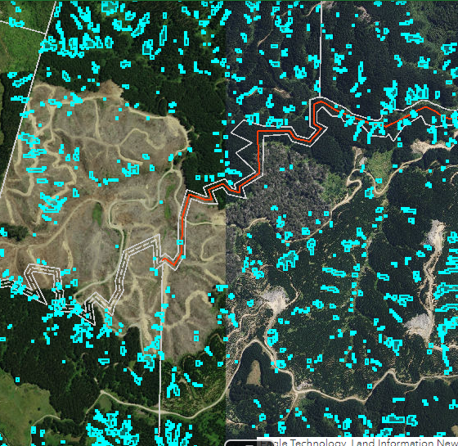
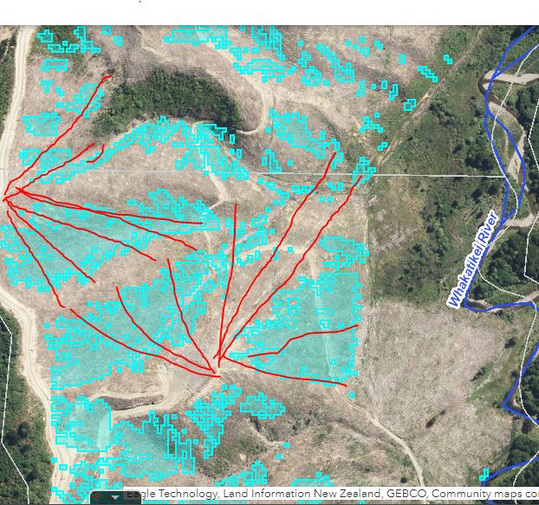
Practical impact of high erosion risk class.
Complex, expensive and questionable benefit
Unworkable configuration

Slide 15
Issues arising – Erosion risk mapping
Practical Management
Erosion zones likely a poor predictor of landsliding, and sediment connectivity/ delivery.
Small isolated pixels costly to work around – both roads and harvesting + consent multiplier.
Multiple small retirement patches vulnerable – prone to weeds, wind, edge damage.
Significant retirement patches render whole blocks operationally non-viable.
Much of estate area is NES-PF “moderate erosion risk”. Efficacy of additive PC1 vs NES-CF, Justification for stringency not established.
Emission Trading
Forests must be replanted or deregistered.
Or land use change – to native to avoid penalties.
Native regeneration must meet minimum thresholds incl 5 m height by yr 20. Many sites are harsh for native tree species.
Penalties =$10,000’s/ha
Costs – who pays?
Post harvest retirement and native replant – ongoing native management?
Long term weed control / fire risk - Gorse/broom big invaders.
Rates relief potentially negligible if land values decline.
Financial assistance is a matter of Council policy and LTPs – not locked in.
CFG believe matters inadequately addressed in cost benefit evaluation Secn 32. Recent case: Rayonier NZ LTD and Port Blakely Ltd Vs Canterbury Regional Council is relevant. (Hearing 2 matter)

Slide 16
Concluding Statement
PC1 represents a material deviation from the recommendations and signals arising from the work of the Whaitua committees.
CFG do not believe that GWRC has sufficient justification to call on NES-PF Regulation 6 to incorporate significant stringency for rules on forestry.
CFG believe the unsignalled (relative to the Whaitua deliberations), PC1 changes, impose significant potential value loss, asset stranding and high ongoing costs, the environmental justifications of which are poorly established.
All these matters are directly relevant to GWRC’s obligations in terms of consultation and exercising Regulation 6 of the NES-CF and Secn 32 analysis, matters to be further expanded in future hearings.
In seeking relief, CFG take the view that GWRC need to undertake a significant review of its approach to regulation of forestry, working with the industry and the scope of the NES-CF.

