Slide 1
Region-Wide Changes – Hearings Stream 1
Sam O’Brien

Slide 2
Topics and Evidence
3 Separate S42A Reports
Air Quality (Region-wide)
Beds of Lakes and Rivers (Region-wide)
Schedules and Threatened Species Objectives (Region-wide and Whaitua)
Combined Rebuttal Evidence Report covering submitter evidence on Air Quality and Beds of Lakes and Rivers topics

Slide 3
Air Quality
Region-wide & Schedule 1 Process
Plan Change 1 Amendments:
Changes to manage discharges in the Coastal Marine Area giving effect to the NZCPS and existing NRP Objectives
Amend natural gas and water & wastewater rule to provide clarity for plan users
Amends All other discharge rule to avoid inadvertently capturing minor discharges
Updating references to NZ Standards

Slide 4
Air Quality
Key Issues and S42 Amendments
Functional and Operational need for activities in the Coastal Marine Area
Agrichemical Rules
Water and Wastewater Rule
Climate Change
Submitter Evidence Issues
Wellington Water Ltd seek specific reference to drinking water in Rule R35

Slide 5
Beds of Lakes and Rivers
Region-wide - Schedule 1 Process & Freshwater Planning Process
Plan Change 1 Amendments:
Amending general conditions to protect indigenous birds in Schedules F2a and F2b
Amending New Structures Rule to limit the extent of listed permitted structures
Minor wording amendments to extraction Rules R132 and R133
New Rule 151A for the Ongoing diversion of a river

Slide 6
Beds of Lakes and Rivers
Key Issues and S42 Amendments:
Effect of amendment to general conditions
Permitted Structures under Rule R128
Appropriateness of new diversion Rule R151A
Submitter Evidence Issues and Rebuttal Amendments
Wellington Water Ltd concern with restrictive general condition (n)
Wellington Water Ltd seek inclusion of pipes & pipelines, and a definition
Multiple Submitters retain concerns with appropriateness of new diversion rule

Slide 7
Schedules and Threatened Species Objectives
Region-wide and Whaitua - Schedule 1 Process & Freshwater Planning Process
Plan Change 1 Amendments:
Identifying Nationally Threatened Freshwater Species and their habitat in the Schedules (Whaitua)
New Nationally Threatened Freshwater Species Objectives and Definition (Whaitua)
Updates to Schedules F4 and F5 (Region-wide)

Slide 8
Schedules and Threatened Species Objectives
Key Issues and S42 Amendments
Inclusion of specific species and values
Alignment of new Objectives and Definitions with the NPS-FM
Minor miscellaneous issues

Slide 9
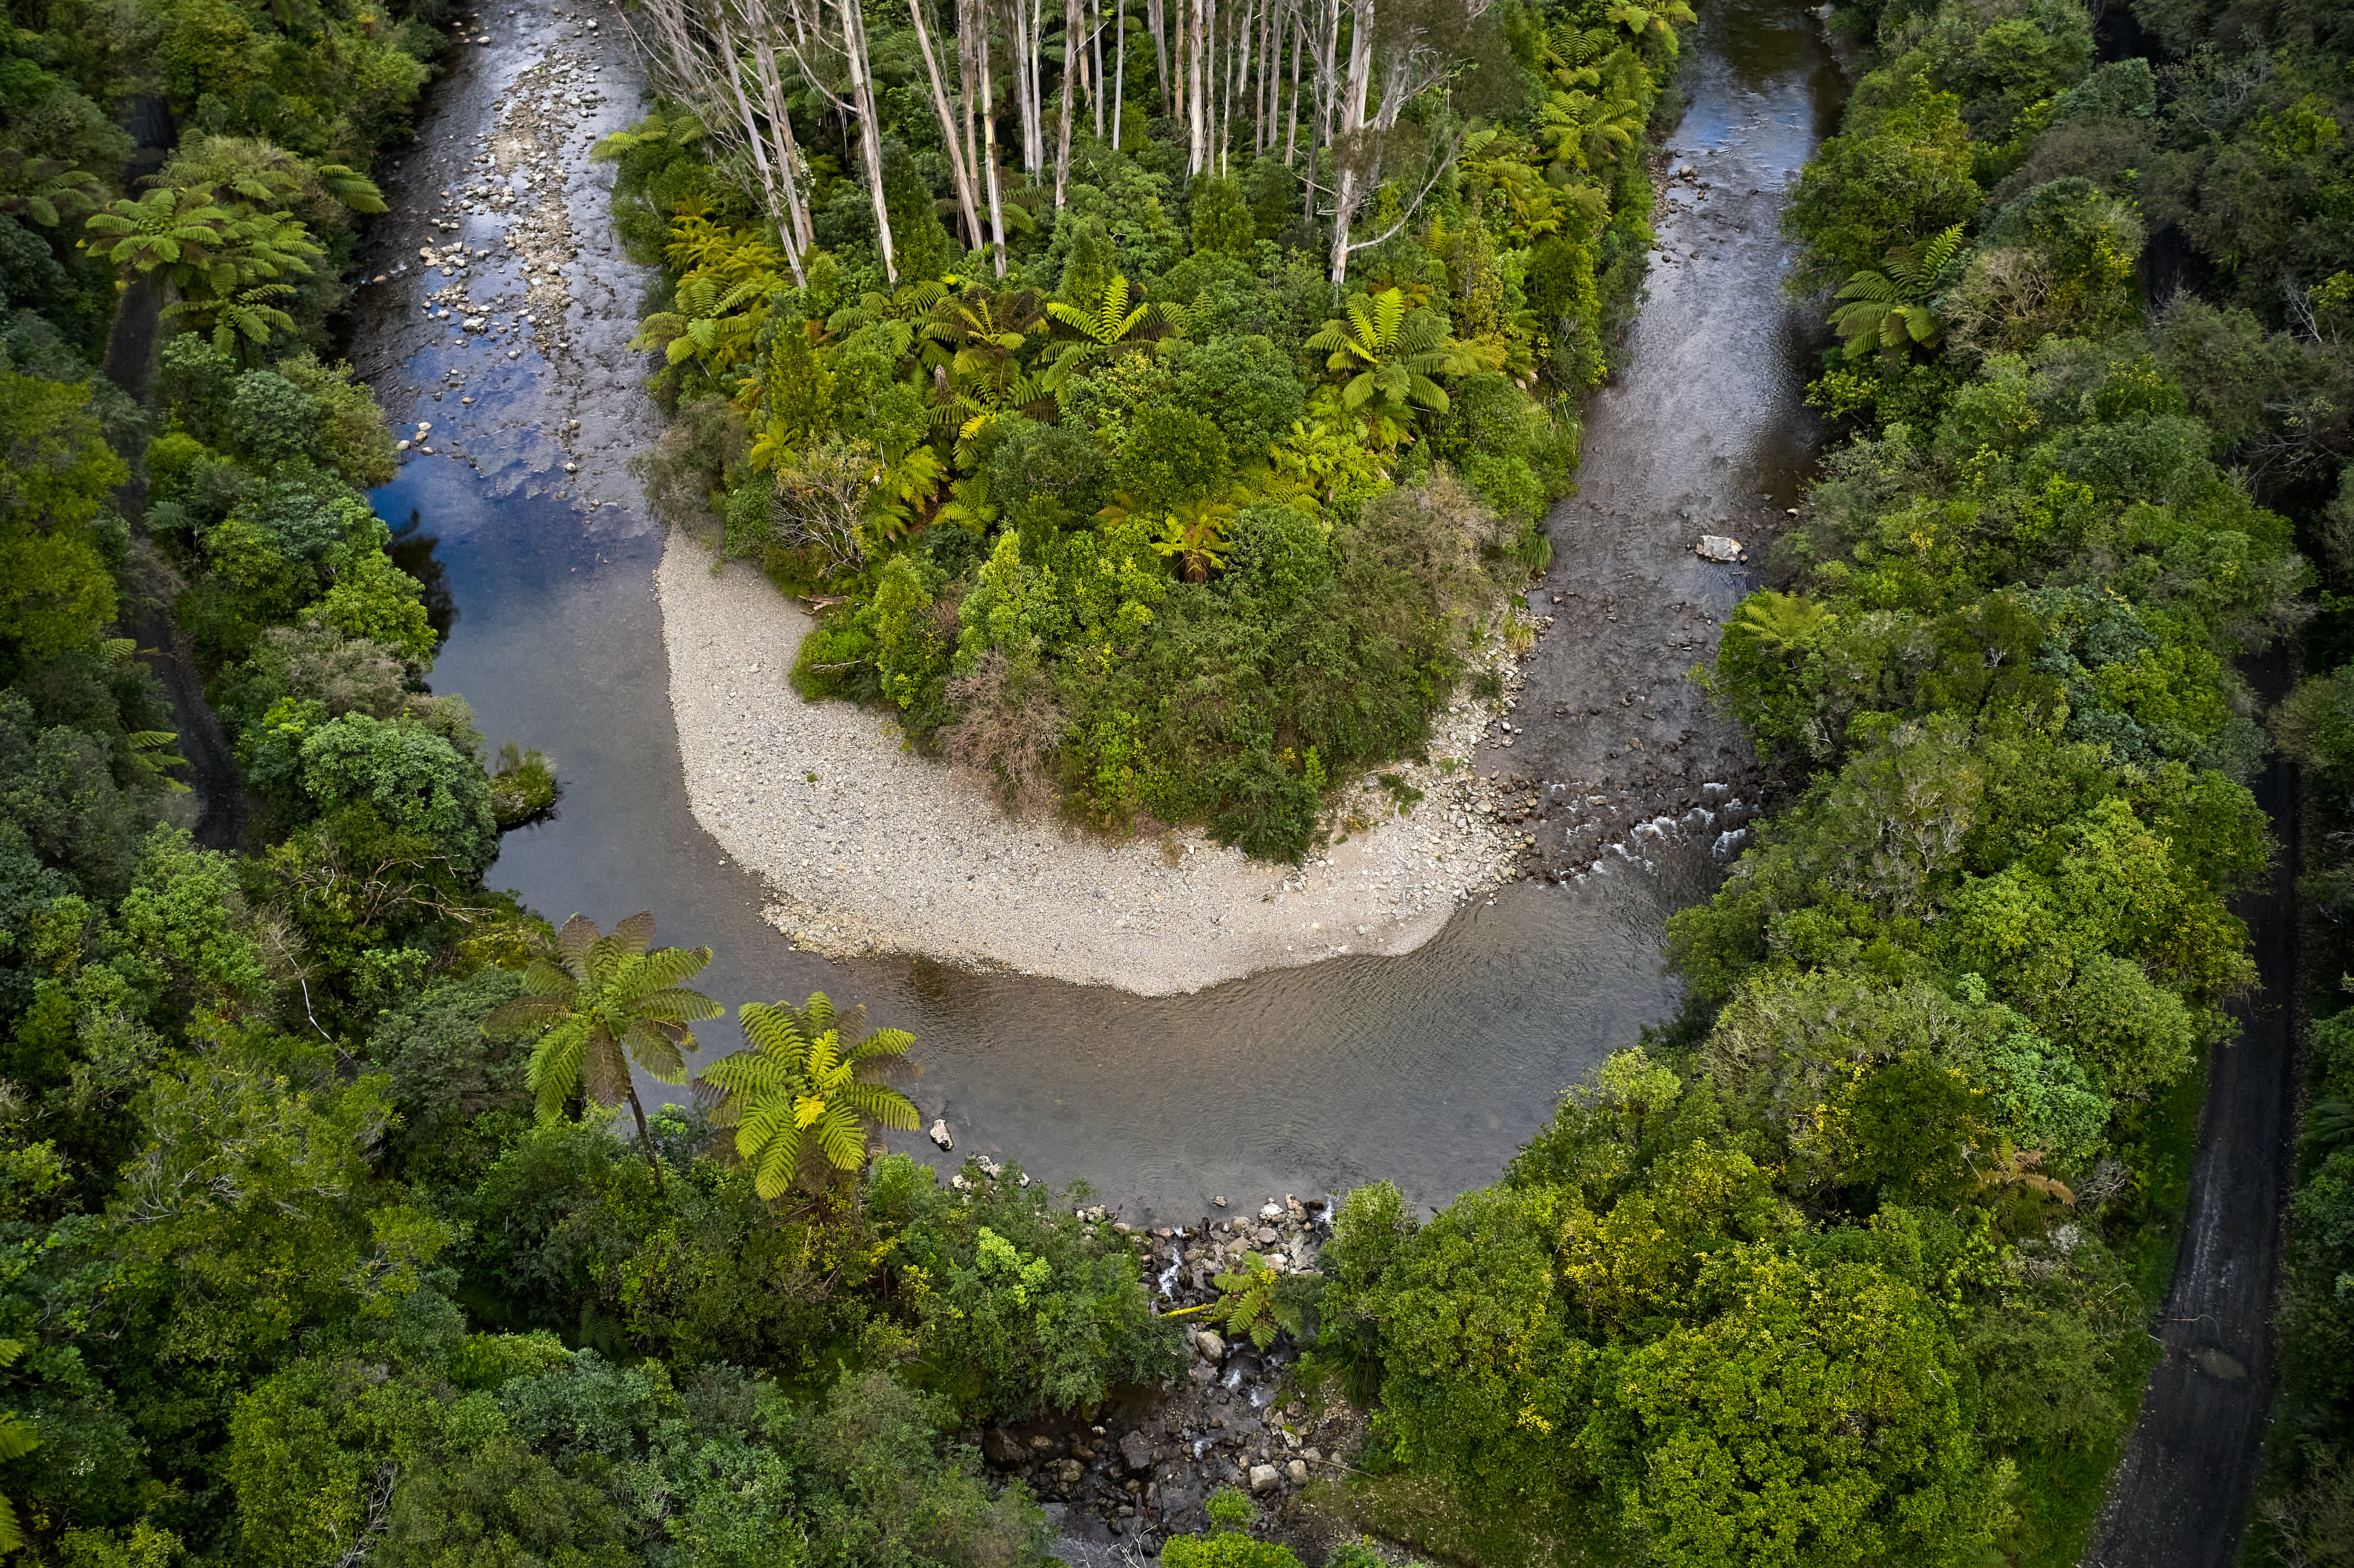
Questions?

